Slide 1
Predicting Customer Satisfaction in the Airline Industry
Team 6 – Joshua Farina (joshuapfarina), Henri Salomon (henri_salomon), Raajitha Middi (Raajitha_Middi), Ryan Chandler (zujin87), Alejandro Martinez (amzeta)
Notes:
My name is Alejandro Martinez from Team 6 and I will be discussing our project on predicting customer satisfaction in the airline industry.

Slide 2
Project Overview
We intend to use airline passenger satisfaction survey data to determine which factors drive customer satisfaction (or dissatisfaction) so that we can provide actionable recommendations on how money should be invested or re-allocated to keep passengers satisfied.
Customer satisfaction is a key factor in attracting and retaining business. Identifying factors that have the strongest effect on customer satisfaction will provide key insights for airlines to enhance their services, improve the customer experience and optimize business operations.
Some estimates indicate that increasing customer retention by as little as 5% increases profits by 25%-95%.¹
Notes:
We intend to use a dataset consisting of airline passenger satisfaction survey results to understand which factors are most important to customers and provide recommendations on how money should be invested or re-allocated.
Customer satisfaction is a main driver in attracting and retaining business. By finding the most important factors we can provide key insights for airlines to enhance their services, improve the customer experience and optimize business operations.
Some estimates indicate that increasing customer retention by as little as 5% increases profits by 25-95%.

Slide 3
Dataset Overview
The dataset is taken from surveys from a US airline and is publicly available on Kaggle.
It includes user ratings for multiple aspects of air travel such as food and drink and seat comfort, as well as customer information such as age and gender.²
Notes:
Here is an overview of our dataset which contains user ratings for multiple aspects of air travel.
It is important to note that the last row, shown in the orange box, indicates whether the passenger was satisfied or not. This is the dependent variable that we will fit our models to.

Slide 4
Dataset Overview
The dataset is taken from surveys from a US airline and is publicly available on Kaggle.
It includes user ratings for multiple aspects of air travel such as food and drink and seat comfort, as well as customer information such as age and gender.²
Notes:
The green boxes show our prediction as to what we expect to be the most important factors in customer satisfaction.
Some examples are that Longer flight distances lead to lower satisfaction due to travel fatigue.
We expect Departure and arrival delays to be the most important factors because people usually have plans that they don’t want to have to reschedule.

Slide 5
Dataset Overview
The dataset is taken from surveys from a US airline. It includes user ratings for multiple aspects of air travel such as food and drink and seat comfort, as well as customer information such as age and gender.²
Highly correlated
Notes:
Departure delay and arrival delay are highly correlated and arrival delay has missing values so we will be excluding arrival delay. ID is removed because it doesn’t provide useful information for modeling.

Slide 6
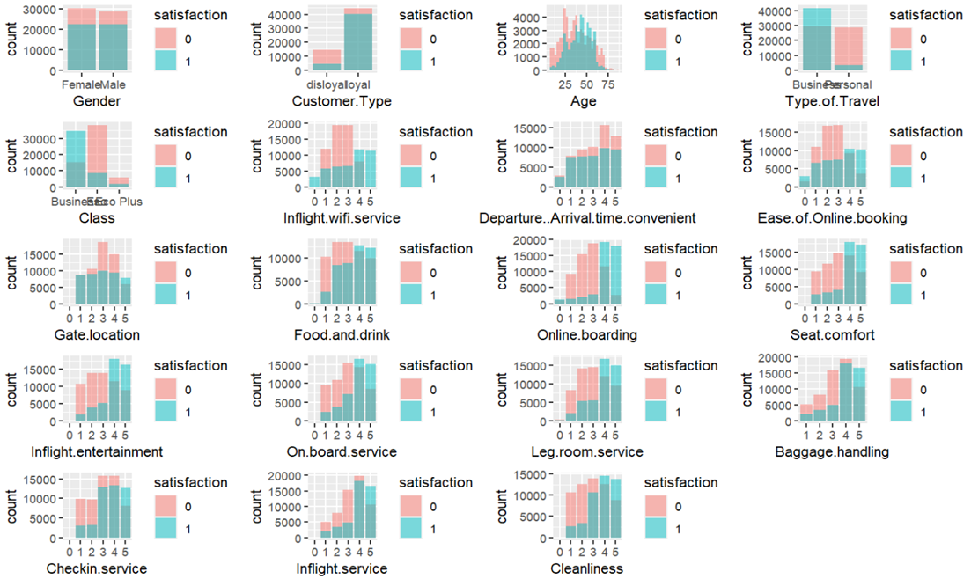
Dataset Overview
Gender doesn’t seem to play a major role in satisfaction as both have almost the same satisfaction levels.
Business class passengers have higher satisfaction levels, particularly in Checkin.service, Seat.Comfort, and Food.and.drink compared to Eco Plus and Economy class
Notes:
Departure delay and arrival delay are highly correlated and arrival delay has missing values so we will be excluding arrival delay. ID is removed because it doesn’t provide useful information for modeling.

Slide 7
Dataset Overview
Passengers express greater dissatisfaction with services like Inflight.wifi.service, Inflight.entertainment, Baggage.handling, On.board.service, Inflight.service. Only when the ratings of these services are above 3, there are more passengers who are satisfied but then this number doesn’t seem to be significantly large.
Notes:
Departure delay and arrival delay are highly correlated and arrival delay has missing values so we will be excluding arrival delay. ID is removed because it doesn’t provide useful information for modeling.

Slide 8
Dataset Overview
The dataset is taken from surveys from a US airline. It includes user ratings for multiple aspects of air travel such as food and drink and seat comfort, as well as customer information such as age and gender.²
Notes:
Departure delay and arrival delay are highly correlated and arrival delay has missing values so we will be excluding arrival delay. ID is removed because it doesn’t provide useful information for modeling.

Slide 9
Modeling
Logistic Regression
Decision Tree
Random Forest
Support Vector Machines
Notes:
Departure delay and arrival delay are highly correlated and arrival delay has missing values so we will be excluding arrival delay. ID is removed because it doesn’t provide useful information for modeling.

Slide 10
Sources
https://www.forbes.com/sites/forbesbusinesscouncil/2022/12/12/customer-retention-versus-customer-acquisition/?sh=3cef46fc1c7d
https://www.kaggle.com/datasets/teejmahal20/airline-passenger-satisfaction
https://www.sciencedirect.com/science/article/pii/S0969699723000844#bib20
https://www.sciencedirect.com/science/article/abs/pii/S0969699719302959
https://www.sciencedirect.com/science/article/pii/S2352340923002421
https://psycnet.apa.org/record/1989-10632-001
https://www.techscience.com/cmc/v75n1/51460/pdf

Slide 11
Project Instructions
What is it?
The submission itself will be a video presentation 10-12 minutes in length that explains your entire project.
The video should show your slides (e.g., as pdf/ppt/slides/or similar on your computer screen via screen capture, say using QuickTime, MonoSnap, Screen Recorder etc.) with voice narration; it is up to you whether to show your face. You should be able to create this recording quickly with little effort – no need to do any special video or audio editing although if you feel the need to it is permitted.
It will cover from start to finish all the key highlights and work you’ve done for the past few months. It will also effectively summarize your findings and conclusions.
Imagine that this video would be the result you present to a manager at the culmination of an internal project who may or may not be familiar with all the details and purpose of the project. Take care to explain everything clearly and provide proper background knowledge.
It is alright to assume your audience has some familiarity with statistical models.
What to Include & What is Required?
All group members are required to appear in the presentation both by audio at minimum and preferably by visual as well (however visual is still optional).
Group members should include their names and introduce themselves before speaking
Each group member should be featured for a similar amount of time
Visuals and Slides are necessary; DO NOT just read your final paper/results
Include audio narration
We would like each group member to cover a similar length of the video. Obviously exactly equal time would be impractical to the flow of the presentation but try to keep everyone’s presentation time similar

Slide 12
Project Instructions
Overview of Project:
Team members' names listed in the presentation.
Necessary background information/framing of the problem.
Include an overview of the problem in general as well as your general approach.
State initial hypotheses.
Overview of Data:
How involved was the cleaning process?
What were your key variables?
Any interesting insights from EDA?
If you used feature engineering how and was it successful?
Where did the dataset come from?
Super quick overview of the data.
Overview of Modeling:
What type of models did you use?
How do they compare?
How did you perform model selection?
How did you perform hyperparameter optimization?
How did the models perform generally speaking?
Are they useful and in what ways?
Why did you choose those models in particular?
Include a couple of key visualizations and be sure to include captions, labels, legends, and most importantly context where needed!
If you encounter any unexpected problems, challenges, or interesting findings please mention these. Discussion of things that didn’t work is also encouraged.
Is there any unfinished business or areas which if given more time or resources you would deem promising or interesting to further pursue?
Overall conclusion and key takeaways from your project as a closing message.
Sources cited on the last slide (no need to read them just include them).

